Slide 1
DevOps Training PwC
1-5 April, 2019
Albert Anthony

Slide 2
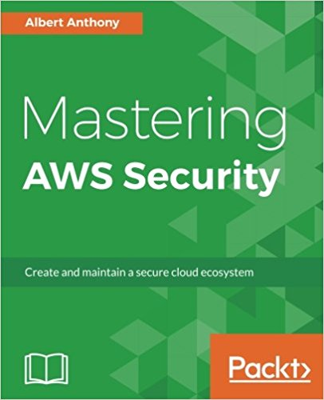
Introductions
Founder of Loves Cloud (www.loves.cloud)
Trainer & Consultant
Containers, DevOps, Cloud & Serverless
Author – Mastering AWS Security

Slide 3
Setting Expectations
Topics Covered
Docker Hands-On (8 Labs)
Kubernetes Hands-On (6 Labs)
Jenkins Hands-On (4 Labs)
Azure DevOps Hands-On (2 Labs)
Elastic Kubernetes Service Hands-On (3 Labs)
Azure Kubernetes Service Hands-On (3 Labs)
26 Hands-on Labs

Slide 4
Pre-requisites
Putty/GitBash on Laptop to Connect to Remote Server
Internet – HotSpot to Connect to Remote Server
Resources:
Launching Your Own Server in Cloud
GitHub Account
Docker Hub Account

Slide 5
Training Methodology
Less theory, more labs
Fully functional environment for all participants
Servers and software pre-installed
Hands-on labs for all topics
Team and individual assignments
Best Practices
Lab instructions document
Labs similar to real projects
All training material to be shared with participants

Slide 6
Training Schedule – Day 1
Introductions
Setting Expectations
Overview of Training
Launching Your Own Servers in AWS
Docker Deep Dive

Slide 7
Training Schedule – Day 2
Docker Images for Python and .NET
Install Kubernetes Cluster on Bare Metal
Multi Master (Highly Available Configuration)

Slide 8
Training Schedule – Day 3
Finish Kubernetes Installation
Running Dockerized Applications on K8 Cluster
K8 Cluster Monitoring
Launch Server Through Ansible Playbook
DevSecOps Best Practices

Slide 9
Training Schedule – Day 4
K8 Cluster Monitoring
Jenkins Overview
CI/CD Pipelines with Jenkins
Deploy Dockerized App on K8 Cluster using Jenkins

Slide 10
Training Schedule – Day 5
CI/CD Pipelines with Azure DevOps
Deploy Dockerized App on Server using Azure DevOps
Overview of EKS with labs
Overview of AKS with labs

Slide 11
Download Lab Instructions
https://github.com/albertlovescloud/pwctraining

